Slide 1

Fraud Analysis Using Machine Learning
: -Devanshu Shrivastava

Slide 2
What?
Problem Statement: -
In this capstone project, you are going to analyze customer’s purchase data set and build a machine learning algorithm to detect fraud purchases.
Solution: -
Considering given set of data and attributes build a model which will be able to process key attributes from given historical data and predict which set of customer are likely to be fraud and leading to a higher positive conversion ratio and reducing the overall bad conversion ratio to reduce no. of frauds as soon as possible.

Slide 3
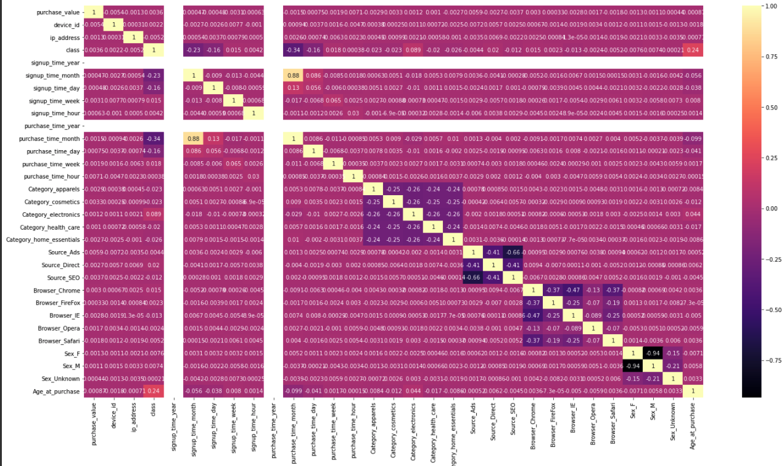
How?
Based on the combination of getdummies, label encoder and mutual info test above best fit attributes were identified which were used to optimize the model.

Slide 4
How? Insights.
Frauds happens in every item category equally whether it is apparels,cosmetics,electronics or home essentials.
Frauds happens through the sources which are the most is Ads, SEO and chrome browser.The second most source of fraud is Internet explorer,firefox and safari and the third most source of fraud is Opera.We really need to increase the security through which frauds happens accordingly
According to analysis,Males have less transaction than females but do more frauds than females(It is not necessarily that person filling gender box before doing fraud is actually correct).
Age at purchase plays an important role because people who have less duration between signup time and purchase time are more likely to be fraud(Not necessarily all) but fraud person may not necessarily make frauds with the same identity.

Slide 5
Why?
Prediction (10,88,650) | Predicted: No | Predicted: Yes | Count
Actual: No | (True Negative) 50 *34115 = 17,05,750 | (False Positive) -500* 125 = -62,500 | 16,43,200
Actual: Yes | (False Negative) -500 * 1330 = -6,65,000 | (True Positive) 50*2208 = 1,10,400 | -5,54,600
Count |  |  | 10,88,650
Attribute | Score
Accuracy | 96.14%
Recall | 62%
F1 Score | 75%
Value | Cost per Customer | Count | Total Cost
TN | 50 | 34115 | 17,05,750
FN | -500 | 1330 | -6,65,000
FP | -500 | 125 | -62,500
TP | 50 | 2208 | 1,10,400
Total |  | 37778 | 10,88,650
Cost of ML per customer for period of implementation and usage is 50 rs/person.

Slide 6
Why? Insights.
As per the previous cost analysis against the Confusion Matrix score of the Model it is evidently clear that business is going to gain if we are able to detect fraud as soon as possible.
Other factors to consider implementing model in production are as below
Cost of the ML model development and deployment is one time cost.
Their will be cost of Maintenance, but it would be quite on lower side compared to gains in business over the time.

Slide 7
Appendix
Model Used :- K-Nearest Neighbour classifier
Accuracy score of 96.14% was obtained with important features and technique.
While Recall is 62%and F1 is 75%.

Slide 8
Thank You

